Slide 1

Learning Objectives
LO1 Explain the purpose of the allowance method for recording losses from uncollectible accounts.
LO2 Estimate uncollectible accounts expense using an aging of accounts receivable.
LO3 Record the adjusting entry for the allowance for uncollectible accounts.
© 2014 Cengage Learning. All Rights Reserved.

Slide 2
Allowance Method of Recording Losses from Uncollectible Accounts
Lesson 14-1
LO1
Accounts receivable that cannot be collected are called uncollectible accounts.
Some businesses refer to uncollectible accounts as bad debts.
Crediting the estimated value of uncollectible accounts to a contra account is called the allowance method of recording losses from uncollectible accounts.
Continued on the next slide.

Slide 3
Allowance Method of Recording Losses from Uncollectible Accounts
Lesson 14-1
LO1
The difference between an asset’s account balance and its related contra account balance is called book value.
The difference between the balance of Accounts Receivable and its contra account, Allowance for Uncollectible Accounts, is called the book value of accounts receivable.
Continued on the next slide.

Slide 4
Allowance Method of Recording Losses from Uncollectible Accounts
Lesson 14-1
LO1
The amount of accounts receivable a business expects to collect is called the net realizable value.

Slide 5
Methods of Estimating Uncollectible Accounts Receivable
Lesson 14-1
LO2
Two methods are commonly used to estimate uncollectible accounts receivable:
The percent of sales method assumes that a percent of credit sales will become uncollectible.
The percent of accounts receivable method uses an analysis of accounts receivable to estimate the amount that will be uncollectible.

Slide 6
Estimating Uncollectible Accounts Expense
Lesson 14-1
LO2
Analyzing accounts receivable according to when they are due is called the aging of accounts receivable.

Slide 7
Estimating Uncollectible Accounts Expense
Lesson 14-1
LO2
Accounts Receivable as of December 31, 20--
Customer | Account Balance | Current | Days Account Balance Past Due
 |  |  | 1–30 | 31–60 | 61–90 | Over 90
Belk & Jensen | $3,247.36 | $1,495.18 | $1,752.18
Edmonds Hospital | 639.88 |  | 167.48 | $195.36 | $277.04
Lake Automotive | 3,757.82 | 3,151.50 | 606.32
Mason City Schools | 2,489.64 | 2,489.64
Skinner College | 2,578.35 |  |  |  |  | $2,578.35
Triangle Health | 3,154.48 | 3,154.48
Wells Apartments | 4,514.28 | 1,483.21 | 3,031.07
 | $20,381.81 | $11,774.01 | $5,557.05 | $195.36 | $277.04 | $2,578.35
Percent |  | 1.00% | 4.00% | 12.00% | 30.00% | 80.00%
Age Group | Amount | Percent | Uncollectible
Current | $11,774.01 | 1.0% | $117.74
1–30 | 5,557.05 | 4.0% | 222.28
31–60 | 195.36 | 12.0% | 23.44
61–90 | 277.04 | 30.0% | 83.11
Over 90 | 2,578.35 | 80.0% | 2,062.68
 | $20,381.81 |  | $2,509.25
Current Balance of Allowance for Uncollectible Accounts |  |  | 125.15
Estimated Addition to Allowance for Uncollectible Accounts |  |  | $2,384.10
1
Compute the estimate for each age group
2
Compute the total estimate
3
Compute the addition to the allowance account

Slide 8
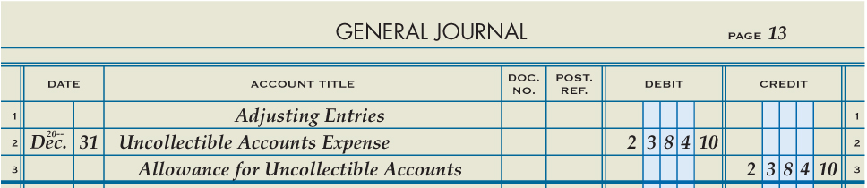
Adjusting Entry for Allowance for Uncollectible Accounts
Lesson 14-1
LO3
Accounts Receivable
Dec. 31 Bal. 20,381.81
Uncollectible Accounts Expense
Adj. 2,384.10
Allowance for Uncollectible Accounts
Bal. 125.15
Adj. 2,384.10
(New Bal. 2,509.25)
1
Write “Adjusting Entries”
2
Date
4
Debit Amount
3
Account Title
5
Account Title
Credit Amount
6

Slide 9

Lesson 14-1 Audit Your Understanding
Lesson 14-1
1. What general ledger accounts are used to account for uncollectible accounts receivable?
ANSWER
The contra asset account Allowance for Uncollectible Accounts and the expense account Uncollectible Accounts Expense

Slide 10
Lesson 14-1 Audit Your Understanding
Lesson 14-1
2. Explain why an adjustment for uncollectible accounts is an application of the Matching Expenses with Revenue concept.
ANSWER
The allowance method of recording losses from uncollectible accounts attempts to match the expense of uncollectible accounts in the same fiscal year that the related sales are recorded.

Slide 11
Lesson 14-1 Audit Your Understanding
Lesson 14-1
3. What are the two methods used to estimate uncollectible accounts receivable?
ANSWER
1. Percent of sales method
2. Percent of accounts receivable method

Slide 12
Lesson 14-1 Audit Your Understanding
Lesson 14-1
4. How is Accounts Receivable affected by the estimate of uncollectible accounts?
ANSWER
The account is not affected.

Slide 13
Work Together 14-1 On You Own 14-1
Work Together
14-1 (Excel)
Modeled
Page 417
On Your Own
14-1 (Excel)
Complete
Page 417

Slide 14

Learning Objectives
LO4 Write off an uncollectible account receivable.
LO5 Account for the collection of an account receivable that was written off.
© 2014 Cengage Learning. All Rights Reserved.

Slide 15
Journalizing the Writing Off of an Uncollectible Account Receivable
Lesson 14-2
LO4
Canceling the balance of a customer account because the customer does not pay is called writing off an account.

Slide 16
Journalizing the Writing Off of an Uncollectible Account Receivable
Lesson 14-2
LO4
January 25. Wrote off Edmonds Hospital’s past due account as uncollectible, $639.88. Memorandum No. 58.
GENERAL LEDGER
Allowance for Uncollectible Accounts
Jan. 25 639.88
Bal. 2,509.25
(New Bal. 1,869.37)
Accounts Receivable
Bal. 21,843.15
(New Bal. 21,203.27)
Jan. 25 639.88
ACCOUNTS RECEIVABLE LEDGER
Edmonds Hospital
Bal. 639.88
(New Bal. 0.00)
Jan. 25 639.88

Slide 17
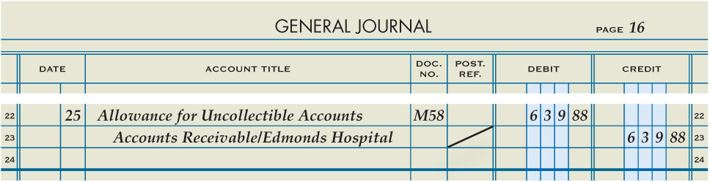
Journalizing the Writing Off of an Uncollectible Account Receivable
Lesson 14-2
LO4
January 25. Wrote off Edmonds Hospital’s past due account as uncollectible, $639.88. Memorandum No. 58.
1
Date
2
Account Title
3
Memorandum Number
4
Debit Amount
5
Account Title and Customer Name
Diagonal Line
6
7
Credit Amount

Slide 18
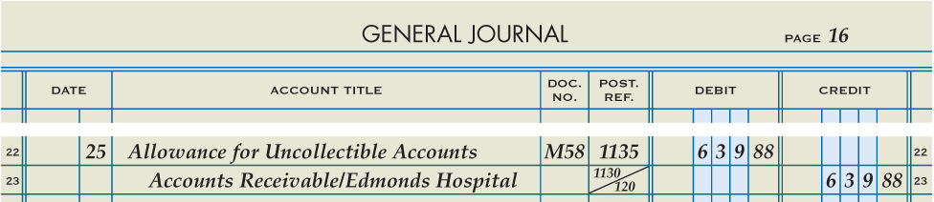
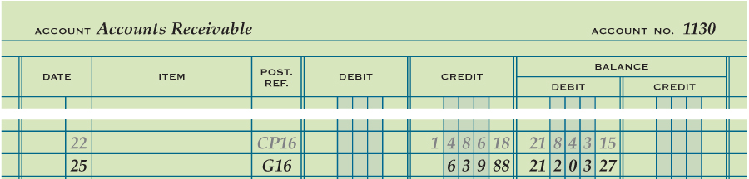
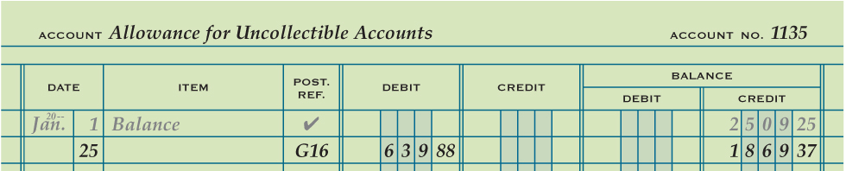
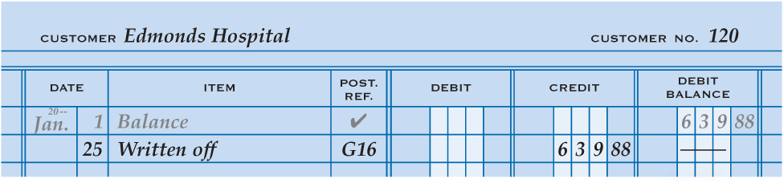
Posting an Entry to Write Off an Uncollectible Account Receivable
Lesson 14-2
LO4
Journal Page Number
Account Number
Date
1
3
6
4
Debit or Credit Amounts
5
Account Balance
1
3
4
5
2
Write “Written off”
6
1
3
4
5

Slide 19
Reopening an Account Previously Written Off
Lesson 14-2
LO5
March 9. Received cash in full payment of Edmonds Hospital’s account, previously written off as uncollectible, $639.88. Memorandum No. 71 and Receipt No. 695.
GENERAL LEDGER
Accounts Receivable
Bal. 21,843.15
Mar. 9 639.88
(New Bal. 21,843.15)
Jan. 25 639.88
Allowance for Uncollectible Accounts
Jan. 25 639.88
Bal. 2,509.25
Mar. 9 639.88
(New Bal. 2,509.25)
ACCOUNTS RECEIVABLE LEDGER
Edmonds Hospital
Bal. 639.88
Mar. 9 639.88
(New Bal. 639.88)
Jan. 25 639.88

Slide 20
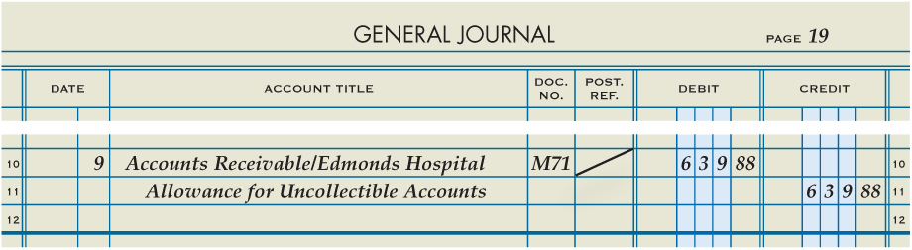
Reopening an Account Previously Written Off
Lesson 14-2
LO5
March 9. Received cash in full payment of Edmonds Hospital’s account, previously written off as uncollectible, $639.88. Memorandum No. 71 and Receipt No. 695.
1
Date
2
Account Title and Customer Name
4
Diagonal Line
Account Title
Memorandum Number
6
3
Debit Amount
Credit Amount
5
7

Slide 21
Recording Cash Received for an Account Previously Written Off
Lesson 14-2
LO5
March 9. Received cash in full payment of Edmonds Hospital’s account, previously written off as uncollectible, $639.88. Memorandum No. 71 and Receipt No. 695.
GENERAL LEDGER
Cash
Mar. 9 639.88
Accounts Receivable
Bal. 21,843.15
Mar. 9 639.88
(New Bal. 21,203.27)
Bal. 639.88
Mar. 9 639.88
ACCOUNTS RECEIVABLE LEDGER
Edmonds Hospital
Bal. 639.88
Mar. 9 639.88
(New Bal. 0.00)
Jan. 25 639.88
Mar. 9 639.88

Slide 22
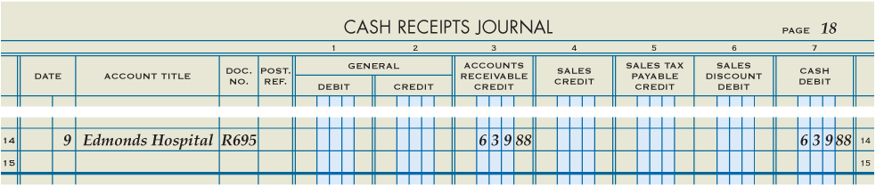
Recording Cash Received for an Account Previously Written Off
Lesson 14-2
LO5
March 9. Received cash in full payment of Edmonds Hospital’s account, previously written off as uncollectible, $639.88. Memorandum No. 71 and Receipt No. 695.
1
Date
2
Customer Name
Receipt Number
3
Credit
4
Debit
5

Slide 23
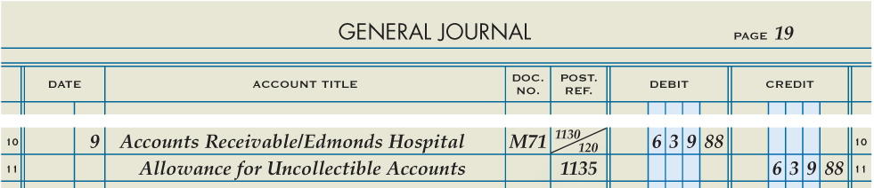
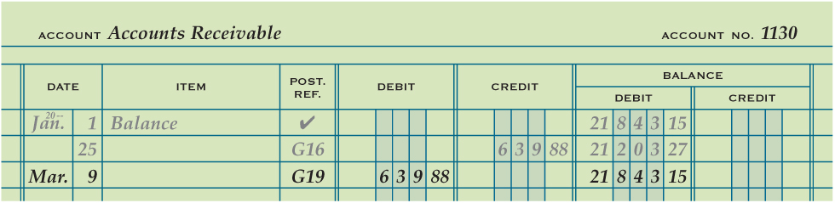
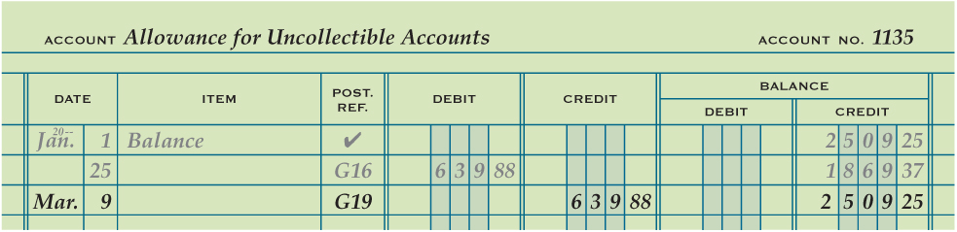
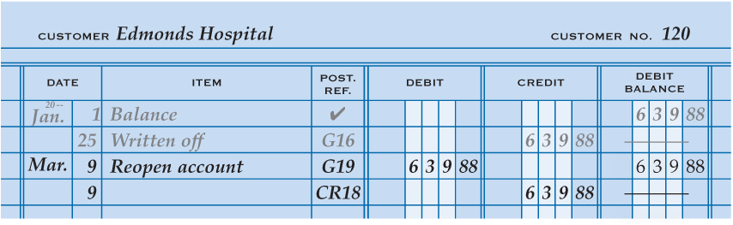
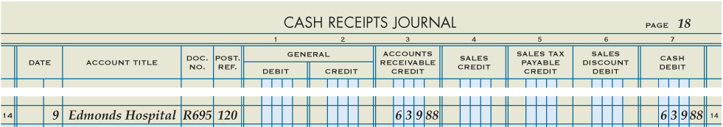
Posting Entries for Collecting a Written-Off Account Receivable
Lesson 14-2
LO5
1. Post the general journal entry to the general ledger.
1
2. Post the debit portion of the general journal entry to the customer account.
3. Write the words Reopen account in the Item column of the customer account.
1
4. Post the cash receipts journal entry to the customer account.
2
3
4

Slide 24
Lesson 14-2 Audit Your Understanding
Lesson 14-2
1. Why is Allowance for Uncollectible Accounts debited when a customer account is written off?
ANSWER
The balance of the customer account is an actual uncollectible amount and no longer an estimate of an uncollectible amount.

Slide 25
Lesson 14-2 Audit Your Understanding
Lesson 14-2
2. Does the book value of accounts receivable differ before and after writing off an account? Explain.
ANSWER
The book value is the same because the same amount is deducted from the accounts receivable and the allowance accounts.

Slide 26
Lesson 14-2 Audit Your Understanding
Lesson 14-2
3. Why is a customer account reopened when the account is paid after being previously written off?
ANSWER
To show an accurate credit history

Slide 27
Work Together 14-2 On You Own 14-2
Work Together
14-2 (Excel)
Modeled
Page 424
On Your Own
14-2 (Excel)
Complete
Page 424

Slide 28

Learning Objectives
LO6 Record the acceptance of a note receivable.
LO7 Account for the collection of a note receivable.
LO8 Account for a dishonored note receivable.
© 2014 Cengage Learning. All Rights Reserved.

Slide 29
Understanding Promissory Notes
Lesson 14-3
A written and signed promise to pay a sum of money at a specified time is called a promissory note.
A person or business to whom a liability is owed is called a creditor.
A promissory note signed by a business and given to a creditor is entered in the businesses books as a note payable.
A promissory note that a business accepts from a customer is entered in the business’s books as a note receivable.
Notes payable and notes receivable are frequently referred to simply as notes.
The person or business that signs a note, and thus promises to make payment, is called the maker of a note.
Continued on the next slide.

Slide 30
Understanding Promissory Notes
Lesson 14-3
The person or business to whom the amount of a note is payable is called the payee.
The original amount of a note, sometimes referred to as the face amount, is called the principal.
The percent of the principal that is due for the use of the funds secured by a note is called the interest rate.
The date on which the principal of a note is due to be repaid is called the maturity date.
The length of time from the signing date to the maturity date, usually expressed as the number of days, may be referred to as the time of a note, or term.

Slide 31
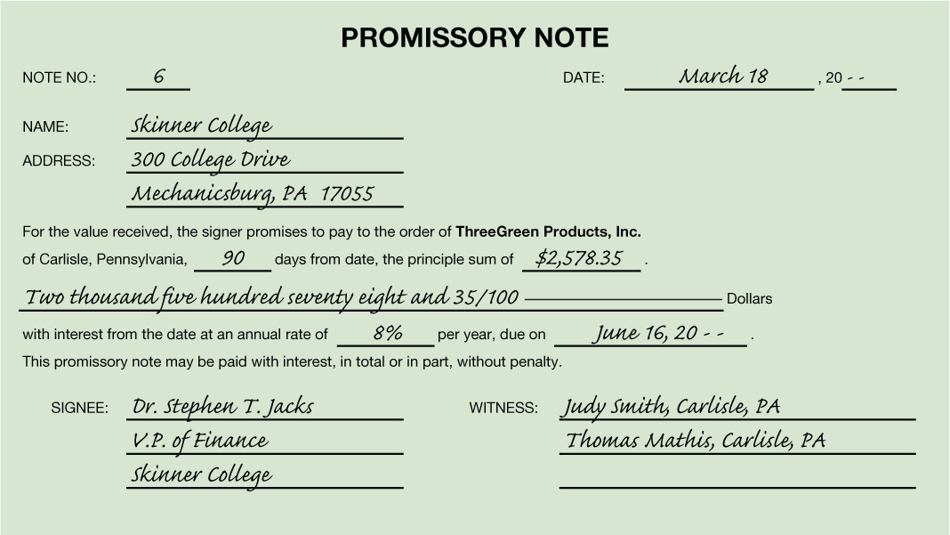
Understanding Promissory Notes
Lesson 14-3
Number Assigned to the Note
Date the Note Is Signed
Time of the Note
Payee
Principal
Maturity Date
Interest Rate
Maker of the Note
Witness

Slide 32
Accepting a Note Receivable from a Customer
Lesson 14-3
LO6
March 18. Accepted a 90-day, 8% note from Skinner College for an extension of time on its account, $2,578.35. Note Receivable No. 6.
GENERAL LEDGER
Notes Receivable
Mar. 18 2,578.35
Accounts Receivable
Bal. 20,486.25
(New Bal. 17,907.90)
Mar. 18 2,578.35
ACCOUNTS RECEIVABLE LEDGER
Skinner College
Bal. 2,578.35
(New Bal. 0.00)
Mar. 18 2,578.35

Slide 33
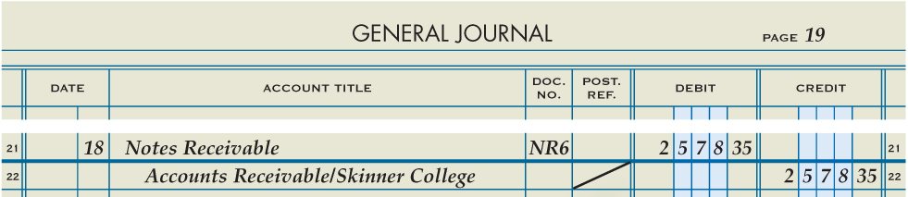
Accepting a Note Receivable from a Customer
Lesson 14-3
LO6
March 18. Accepted a 90-day, 8% note from Skinner College for an extension of time on its account, $2,578.35. Note Receivable No. 6.
2
Account Title
Note Receivable Number
4
Debit Amount
3
Date
1
5
Account Title and Customer Name
Diagonal Line
Credit Amount
6
7

Slide 34
Interest on Promissory Notes
Lesson 14-3
LO7
An amount paid for the use of money for a period of time is called interest.
Principal | × | Annual Interest Rate | × | Time as Fraction of a Year | = | Interest for Fraction of Year
$2,578.35 | × | 8% | × | 90/360 | = | $51.57
The amount that is due on the maturity date of a note is called the maturity value.
Principal | + | Interest | = | Maturity Value
$2,578.35 | + | $51.57 | = | $2,629.92

Slide 35
Maturity Date of Promissory Notes
Lesson 14-3
LO7
Number of days of the first month
Days remaining after this month
1
2
 | Days from the Month | Days Remaining
Term of the Note |  | 90
March 18–March 31 | 13 | 77
April | 30 | 47
May | 31 | 16
June 1–June 16 | 16 | 0
Lesser of the days of the month and the days remaining after the previous month
3
4
Days remaining for the last month

Slide 36
Collecting Principal and Interest on a Note Receivable
Lesson 14-3
LO7
When a note receivable reaches its maturity date, the maker of the note is expected to pay the maturity value to the payee.
The interest earned on money loaned is called interest income.
The interest earned on a note receivable is credited to a revenue account titled Interest Income.

Slide 37
Collecting Principal and Interest on a Note Receivable
Lesson 14-3
LO7
June 16. Received cash for the maturity value of Note Receivable No. 6, a 90-day, 8% note: principal, $2,578.35, plus interest, $51.57; total, $2,629.92. Receipt No. 782.
Cash
Mar. 18 2,629.92
Notes Receivable
Mar. 18 2,578.35
(New Bal. 0.00)
June 16 2,578.35
Interest Income
June 16 51.57

Slide 38
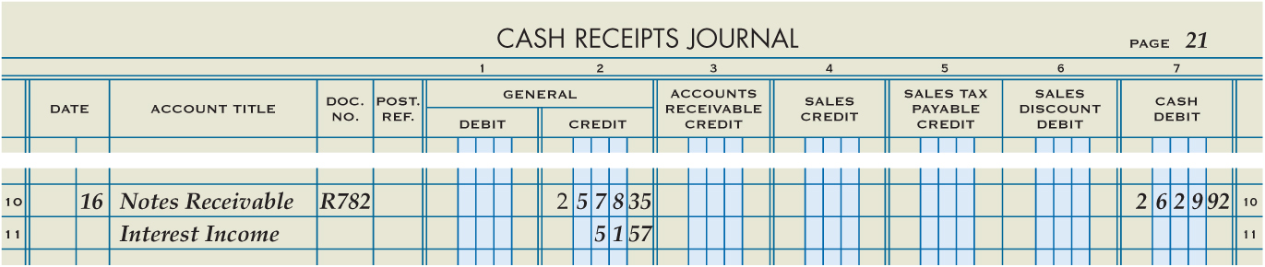
Collecting Principal and Interest on a Note Receivable
Lesson 14-3
LO7
June 16. Received cash for the maturity value of Note Receivable No. 6, a 90-day, 8% note: principal, $2,578.35, plus interest, $51.57; total, $2,629.92. Receipt No. 782.
Account Title
2
3
Receipt Number
4
Principal Amount
Date
1
5
Account Title
6
Interest Amount
Credit Amount
7

Slide 39
Recording a Dishonored Note Receivable
Lesson 14-3
LO8
A note that is not paid when due is called a dishonored note.

Slide 40
Recording a Dishonored Note Receivable
Lesson 14-3
LO8
June 3. Stout Company dishonored Note Receivable No. 4, a 60-day, 8% note, maturity value due today: principal, $3,000.00; interest, $40.00; total, $3,040.00. Memorandum No. 98.
GENERAL LEDGER
Accounts Receivable
June 3 3,040.00
Notes Receivable
Apr. 4 3,000.00
(New Bal. 17,907.90)
June 3 3,000.00
Interest Income
June 3 40.00
ACCOUNTS RECEIVABLE LEDGER
Stout Company
June 3 3,040.00

Slide 41
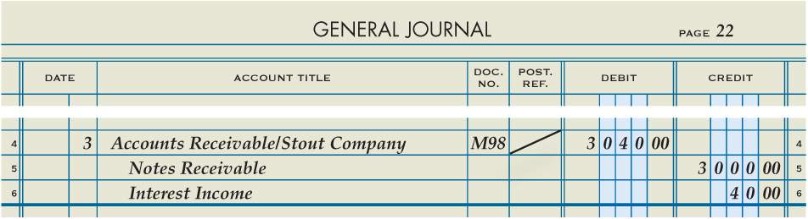
Recording a Dishonored Note Receivable
Lesson 14-3
LO8
June 3. Stout Company dishonored Note Receivable No. 4, a 60-day, 8% note, maturity value due today: principal, $3,000.00; interest, $40.00; total, $3,040.00. Memorandum No. 98.
Account Title, Customer
Name, and Amount
2
Memorandum Number
4
Diagonal Line
3
Date
1
5
6
Account Title and Principal Amount
Account Title and Income Amount

Slide 42
Lesson 14-3 Audit Your Understanding
Lesson 14-3
1. What conditions might cause a business to delay payment to a vendor?
ANSWER
The receipt of cash from sales does not occur at the same time and in amounts sufficient to pay for needed purchases and expenses.

Slide 43
Lesson 14-3 Audit Your Understanding
Lesson 14-3
2. What is the advantage of a promissory note over an account receivable?
ANSWER
A note can be useful in a court of law as written evidence of a debt.

Slide 44
Lesson 14-3 Audit Your Understanding
Lesson 14-3
3. What does an interest rate of 10% mean?
ANSWER
Ten cents will be paid for the use of each dollar borrowed for a full year.

Slide 45
Lesson 14-3 Audit Your Understanding
Lesson 14-3
4. What is written in a customer’s account when (1) a note is accepted and (2) a note is dishonored?
ANSWER
The words (1) Accepted note and (2) Dishonored note are written in the Item column of the customer’s account.

Slide 46
Work Together 14-3 On You Own 14-3
Work Together
14-3 (Excel)
Modeled
Page 430
On Your Own
14-3 (Excel)
Complete
Page 430

Slide 47
Application Problems
14-1 Application Problem
Excel
14-2 Application Problem
Self Correcting Excel

Slide 48
Application Problems
14-3 Application Problem
Self Correcting Excel
14 Mastery Problem
Peachtree

Slide 49
Unit 14 Assessment
Unit 14 Review (ExamView)
90 % or Greater
5 Point Bonus on Unit 1 Concept Quiz (20% Bonus)
Unit 14 Part 1 Quiz (ExamView)
Concepts – 25 Questions (25 Points)
Unit 14 Part 2 Quiz (Excel)
Skills (30 Points)

